Slide 1

TCF’s DNA 2025 Part 3 (of 4)
Our Church’s Identity,
by Andy Acreman
27th April 2025

Slide 2
What is TCF’s DNA?
The foundational principles, beliefs and practices that TCF was ‘born’ with – which God built into us from the mid 1970’s when the church was ‘born’ under Mike Godward’s leadership. 50 years ago!
Today is the third of four teaching sessions
Notes:
Just like DNA in a human, our spiritual DNA defines us as a local church. It’s the combination of all these characteristics that makes Thurrock Christian Fellowship unique.

Slide 3
Our DNA – 1
Gathering Together
The Presence of God in our gatherings and in our lives
The Worship of God
Supernatural Living - Relying on answered prayer and the miraculous power of God in our lives together
Notes:
I have noticed 12 ‘strands’ of DNA that help to define us. I have arranged them in a logical sequence. Here are all twelve.

Slide 4
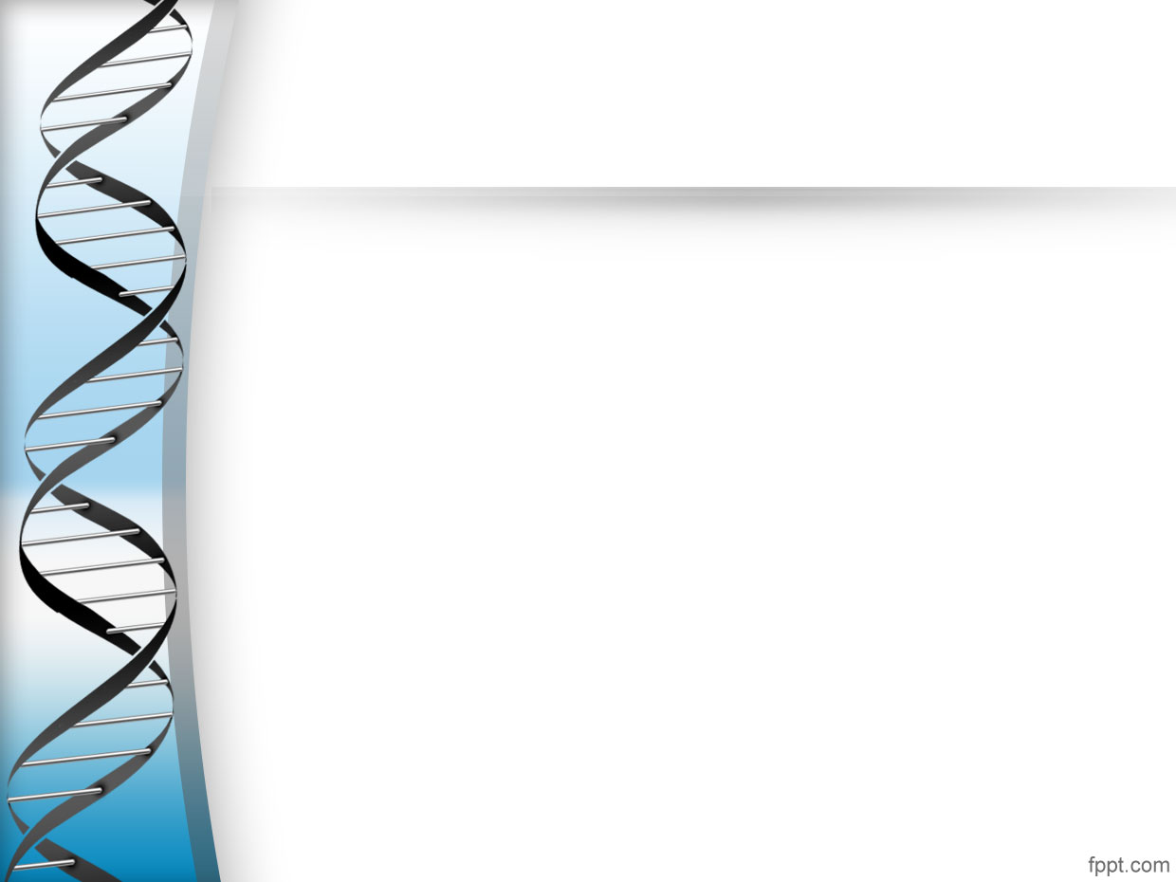
Our DNA – 2
Revelation
Hearing the Voice of God through his Spirit in us
The Bible is True and Inspired - To guide and teach us what living with Jesus is all about
Body Ministry - Each one of us expressing the gifts of the Spirit for the good of God’s people
Notes:
We did these three last time…

Slide 5
Our DNA – 3
Corporate Identity
The Kingdom of God - Bringing the values, vision and power of Heaven to Thurrock
The Bride of Christ, the Body of Christ, and the Family of God – We are part of these heavenly identities in our local area
Leadership is 'Team’
Notes:
Today our focus will be on our corporate identity. What unites us.

Slide 6
Our DNA – 4
Key Attitudes
Welcoming and accessible to all
Generosity as a Heart Attitude
God Receives the Glory – We gratefully give him all the credit for our success
Notes:
Next month we look at the final three characteristics…

Slide 7
Today: Our DNA – 3
Corporate Identity
The Kingdom of God - Bringing the values, vision and power of Heaven to Thurrock
The Bride of Christ, the Body of Christ, and the Family of God – We are part of these heavenly identities in our local area
Leadership is 'Team’ – Together we leaders humbly steer the church by submitting to the Holy Spirit, to one another, and to each other’s areas of gifting. We exercise our authority gently and take our responsibilities seriously
Notes:
Back to Today, then. Our Corporate Identity…

Slide 8
The Kingdom of God - 1
Genesis 11:1-2,4,6-8 NIV. Now the whole world had one language and a common speech. As people moved eastward, they found a plain in Shinar and settled there. Then they said, "Come, let us build ourselves a city, with a tower that reaches to the heavens, so that we may make a name for ourselves; otherwise we will be scattered over the face of the whole earth." The LORD said, "If as one people speaking the same language they have begun to do this, then nothing they plan to do will be impossible for them. Come, let us go down and confuse their language so they will not understand each other." So the LORD scattered them from there over all the earth, and they stopped building the city.
Notes:
The ‘Kingdom of God’ is where God rules and reigns supreme over a people who are willingly submitted to Him, and where God’s power, his character, and his presence are all found. The Kingdom of God is where his people are devoted to His word and His ways. The Kingdom of God is where Jesus is King!
In Genesis chapter eleven, we have a very important story of a worldwide rebellion against God. It describes the third of three great rebellions against his kingship over the world’s people. The other two are found in Genesis 3 and Genesis 6.
We see that a rebellion against God’s took place, probably led by a warrior-giant called Nimrod, and attempted to set up a world-wide empire based in the region of Babylonia. The Tower of Babel! God took this very seriously and deliberately scattered the peoples by giving them hundreds of unconnected languages so they couldn’t communicate and unite.
Fast-forward many thousands of years and we come to the Day of Pentecost after Jesus had risen. The giving of the Holy Spirit was a reversal of Babel, as each person heard the words of God freely in their own language – with all barriers removed.

Slide 9
The Kingdom of God - 2
Genesis 12:1-3 NIV. The LORD had said to Abram, "Go from your country, your people and your father's household to the land I will show you. "I will make you into a great nation, and I will bless you; I will make your name great, and you will be a blessing. I will bless those who bless you, and whoever curses you I will curse; and all peoples on earth will be blessed through you.“
Genesis 18:18-19 NIV. Abraham will surely become a great and powerful nation, and all nations on earth will be blessed through him. For I have chosen him, so that he will direct his children and his household after him to keep the way of the LORD by doing what is right and just, so that the LORD will bring about for Abraham what he has promised him."
Notes:
Back to Babel. God, having rejected the majority of the nations, chose one man – Abraham – and build a new nation from him, to create in Israel the Kingdom of God, where God was loved, worshiped and obeyed.

Slide 10
The Kingdom of God - 3
Deuteronomy 32:8-9 ESV. When the Most High gave to the nations their inheritance, when he divided mankind, he fixed the borders of the peoples according to the number of the sons of God. But the LORD's portion is his people, Jacob his allotted heritage.
Matthew 21:42-43 NIV. Jesus said to them, "Have you never read in the Scriptures: "'The stone the builders rejected has become the cornerstone; the Lord has done this, and it is marvellous in our eyes'? "Therefore I tell you that the kingdom of God will be taken away from you and given to a people who will produce its fruit.
Notes:
In the Book of Deuteronomy, there is a comment about this process… The ‘Sons of God’ are not humans, but powerful spirit rulers and authorities who are meant to serve God and be submitted to His will. They often don’t, however!
In the course of history, Israel – God’s original chosen people – failed to obey Him again and again. God finally rejected them. So when Jesus Himself came to earth, he was tasked with beginning all over again to build the Kingdom of God in a people who were truly willing to obey from the heart. His disciples. Today, this means us!

Slide 11
The Kingdom of God - 4
Mark 1:15 NIV. "The time has come," he said. "The kingdom of God has come near. Repent and believe the good news!“
Matthew 12:28 NIV. But if it is by the Spirit of God that I drive out demons, then the kingdom of God has come upon you.
Mark 10:14 NIV. Jesus said to them, "Let the little children come to me, and do not hinder them, for the kingdom of God belongs to such as these.
Luke 10:9 NIV. Heal the sick who are there and tell them, 'The kingdom of God has come near to you.’
John 3:3 NIV. Jesus replied, "Very truly I tell you, no one can see the kingdom of God unless they are born again."
Notes:
To enter the Kingdom of God you must submit to His Lordship and believe the gospel
Driving our demons is occupying spiritual territory – advancing the Kingdom of God
It must be received… like a child does
Healing is a sign of the advance of God’s Kingdom
The Kingdom is invisible until God has opened your spiritual eyes.
Our aim then, is to bring the values, the vision, and the power of Heaven to Thurrock!

Slide 12
The Bride of Christ, the Body of Christ, and the Family of God…
These are all metaphors of our identity as church...
  Bride
  Body
  Family
Of course, they also identify Jesus as the…
  The Heavenly Bridegroom;
  The Head of the Body; and
  God as our Heavenly Father.
Notes:
If we know that these are all true, we should make every effort to develop a culture that reflects this.

Slide 13
The Bride of Christ
Revelation 21:1-2,9-11 NIV
Then I saw "a new heaven and a new earth," for the first heaven and the first earth had passed away, and there was no longer any sea. 2 I saw the Holy City, the new Jerusalem, coming down out of heaven from God, prepared as a bride beautifully dressed for her husband… 9 One of the seven angels who had the seven bowls full of the seven last plagues came and said to me, "Come, I will show you the bride, the wife of the Lamb." 10 And he carried me away in the Spirit to a mountain great and high, and showed me the Holy City, Jerusalem, coming down out of heaven from God. 11 It shone with the glory of God, and its brilliance was like that of a very precious jewel, like a jasper, clear as crystal.
Notes:
In describing us – the Jesus’ Church – the bible uses yet another metaphor: a great city! We are the Bride of Christ. We collectively develop a love relationship with our heavenly lover – Jesus. We seek him out and spend time with him – individually and corporately. The whole reason we preach, evangelise, grow the church and become more holy is to be that perfect Bride that is promised and devoted to Jesus for ever.
When a young Jewish man had become betrothed to a woman, he returned to his own father’s household and began to build a room or apartment where his future wife and he would later live - in the grounds of his father’s home. Once his father was satisfied that he had completed this, and that all the other preparations had been made for the wedding supper, the bridegroom would leave his father’s house again to collect his new bride and bring her home to live with him. Jesus said to us in John 14:2-3 NIV. “My Father's house has many rooms; if that were not so, would I have told you that I am going there to prepare a place for you? ³ And if I go and prepare a place for you, I will come back and take you to be with me that you also may be where I am”.
Jesus is doing the same now for his Bride, the church!

Slide 14
The Body of Christ
Colossians 1:18 NIV. And he is the head of the body, the church; he is the beginning and the firstborn from among the dead, so that in everything he might have the supremacy.
1 Corinthians 12:27-28 NIV. Now you are the body of Christ, and each one of you is a part of it. ²⁸ And God has placed in the church first of all apostles, second prophets, third teachers, then miracles, then gifts of healing, of helping, of guidance, and of different kinds of tongues.
Notes:
1 Corinthians 12 explains how Jesus is the ‘head’ of the Body of Christ – connected by his lifeblood to every limb and organ in that body – that means us! We are part of a huge living being that is vibrant with the Spirit of God pulsing through it, and through us. Obviously, we need to live in harmony with one another, so that Christ’s body on earth is effective and beautiful

Slide 15
The Family of God
1 Thessalonians 4:9-10 NIV. Regarding your love for one another, we don't need to write to you, as you have been taught by God to love each other. 10 Indeed, you already show love to all of God's family in Macedonia. Still, we encourage you, brothers and sisters, to continue growing in this love.
Hebrews 2:10-11 NIV. In leading many sons and daughters to glory, it was appropriate for God, the one for whom and through whom all things exist, to perfect the pioneer of their salvation through his suffering. 11 Both the one who sanctifies and those who are sanctified are from the same family, which is why Jesus is not ashamed to call them brothers and sisters.
Notes:
God is our Father, Jesus is our Brother and we are all members of his family. Do we treat one another as family members? When the going gets tough, we expect to rely upon our family! We expect to be called upon to assist other family members. How do we feel about one another? Do we really look upon one another as ‘family’? Do we treat one another as ‘family’?
TCF has always had this sense of Bride, Body and Family. We have always been hospitable, kindly and generous with one another.

Slide 16
Leadership is ‘Team’
²³ Paul and Barnabas appointed elders for them in each church and, with prayer and fasting, committed them to the Lord, in whom they had put their trust. (Acts 14)
A strong emphasis that avoids any one leader having undue control over God’s church
Overall, the Holy Spirit is our Lead Leader!
We therefore humbly steer the church by submitting to the Spirit, to one another on the team, and to each other’s areas of gifting
We exercise our authority gently and take our duties seriously
Notes:
We are trying to avoid ‘hierarchical’ structures in TCF as far as we can. We don’t have ‘The Pastor’ – because it’s unbiblical. In TCF we have a ‘flat’ leadership team structure. A team of different gifts and ministries acting in unity.
We all submit to the Holy Spirit, so if we are disagreeing on something fundamental, then we are clearly not hearing Him well enough and need to spend longer waiting on God.
If we disagree about minor things, then we just use this as an opportunity to submit to one another – and not always get our ‘way’
We also tend to give priority to a person’s spiritual gifting in particular areas
Leadership is increasingly about ‘getting out of the Holy Spirit’s way’; gripping the steering wheel very loosely! We spend a lot of our meeting time seeking the will of God. We also listen carefully to what the rest of the Body of Christ is saying.
Commitment is always firstly to the Lord Jesus!

Slide 17
Summary: Our DNA – 3
Corporate Identity
The Kingdom of God - Bringing the values, vision and power of Heaven to Thurrock
The Bride of Christ, the Body of Christ, and the Family of God – We are part of these heavenly identities in our local area
Leadership is 'Team’ – Together we leaders humbly steer the church by submitting to the Holy Spirit, to one another, and to each other’s areas of gifting. We exercise our authority gently and take our responsibilities seriously
Notes:
To Summarise…

Slide 18
Challenges: Our DNA – 3
Corporate Identity
Are we expecting to do those ‘greater things’ that Jesus spoke of (John 14:12) to demonstrate that His Kingdom is coming near?
How would a deeper understanding of us as Bride of Christ, Body of Christ, and Family of God change our attitudes and actions towards one another?
Since ‘Leadership is Team’ – how can I relate better to my leaders and benefit more from their oversight of this church?

Slide 19
TCF’s DNA – END of Part 3
Let’s discuss these ideas in our Community Groups next time they meet up.
Notes:
The things are part of TCF’s DNA. Let’s enjoy them to the max!

